Slide 1
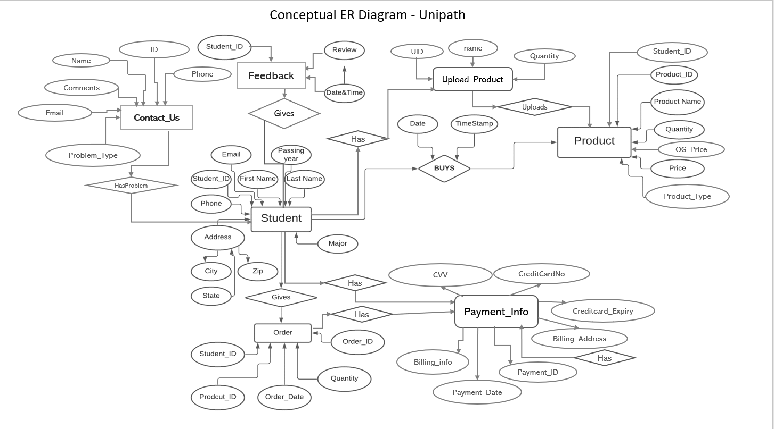

Slide 2
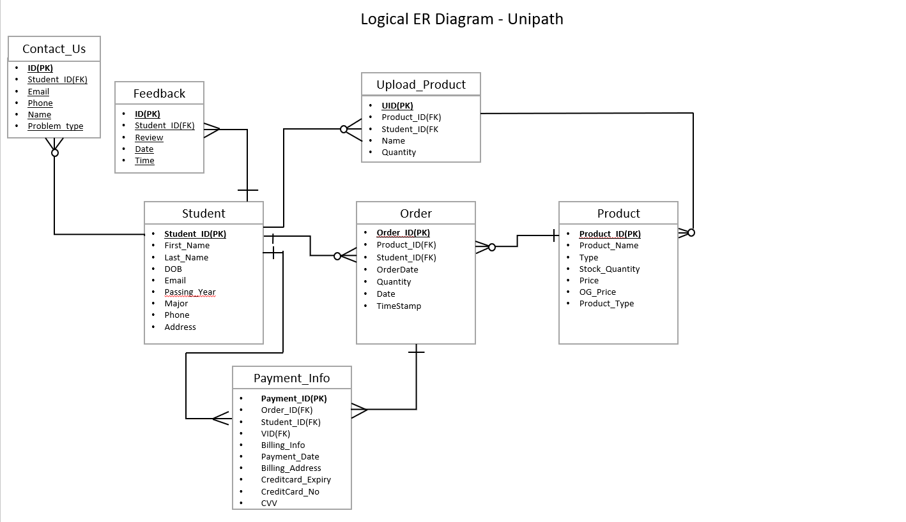

Slide 3
Revision Notes
Ratings feature won’t be needed in the latest iteration.
Ads table won’t be needed in the latest iteration.
Loan table won’t be needed in the latest iteration.

